Slide 1
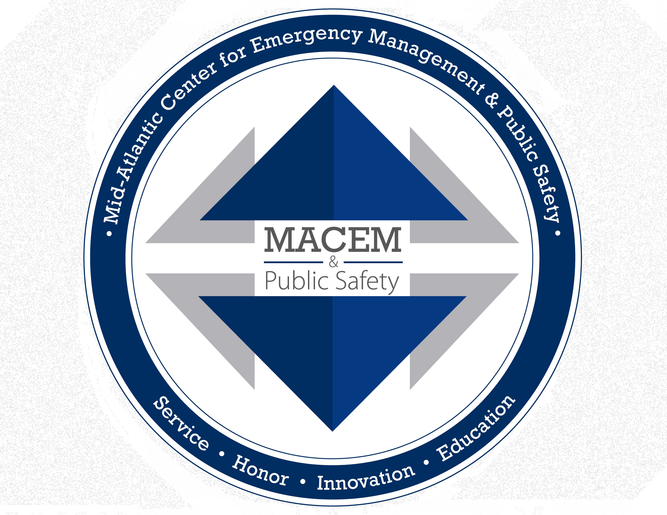
Homeland Security Sciences I
UNIT 2: Science and Technology in Homeland Security
LESSON 3: Science & Technology Programs for Defense Against Catastrophic Threats

Slide 2
Lesson Focus
Learning Objective:
Lesson Topics:
The student will:
Explain the public health significance of Project BioSense and Project BioWatch.
S&T program justification
Research and development
Detection and prevention
Standards and guidelines
Borders security: nuclear and radiological detection
Project BioSense
Project BioWatch

Slide 3
Lesson Resources: Student
Websites:
Recommendations to Prevent Catastrophic Threats. Federation of American Scientists https://fas.org/pir-pubs/fas-symposium-provides-recommendations-to-next-administration-on-catastrophic-threats/
CDC. (2004). BioSense Program https://www.cdc.gov/mmwr/preview/mmwrhtml/su5301a13.htm
DHS. (2021). Science and Technology Directorate, Homeland Security Advanced Research Projects Agency http://www.dhs.gov/st-hsarpa

Slide 4
Lesson Resources: Teacher
CDC. (2004). BioSense Program https://www.cdc.gov/mmwr/preview/mmwrhtml/su5301a13.htm
DHS. (2021). Science and Technology Directorate, Homeland Security Advanced Research Projects Agency http://www.dhs.gov/st-hsarpa
Kass-Hout, T. A. (2009). BioSense Program: Going Forward. Eighth Annual International Society for Disease Surveillance (ISDS) Conference http://ajpmonline.wordpress.com/2011/11/15/cdc%E2%80%99s-biosense-2-0-bringing-together-the-science-and-practice-of-public-health-surveillance-4/
NTI. (2012). DHS Official Opposes Next-Gen BioWatch Sensors http://www.nti.org/gsn/article/dhs-advised-hold-developing-next-gen-biowatch-sensors/
Recommendations to Prevent Catastrophic Threats. Federation of American Scientists https://fas.org/pir-pubs/fas-symposium-provides-recommendations-to-next-administration-on-catastrophic-threats/
Bunn, M., & Harrell, E. (2014). Threat Perceptions and Drivers of Change in Nuclear Security Around the World: Results of a Survey. Cambridge, Mass.: Report for Project on Managing the Atom, Belfer Center for Science and International Affairs, Harvard Kennedy School https://www.belfercenter.org/publication/threat-perceptions-and-drivers-change-nuclear-security-around-world-results-survey

Slide 5
Lesson Outline
Exploration
Identify the DHS Science and Technology programs that make our nation safe.
Understand the advanced technologies, systems, and services that make our nation safer.
Understand the role of federal laboratories that help keep the nation safe and meet the mission of DHS.
Explanation
Prepare a report: Explain the difference between Project BioDefense and Project BioWatch. Pay particular attention to the public health aspects.
Elaboration
Prepare for a discussion: What should be the highest priority science and technology initiatives or systems in place to contribute most significantly to U.S. homeland security?
This is a suggested sequence and pacing guide.
The time and depth needed for these topics is entirely at the discretion of the teacher.
Formative assessments may be informal and embedded in the lesson or formalized graded elements.

Slide 6
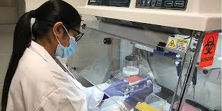
S&T Program Justification
The Homeland Security Advanced Research Projects Agency (HSARPA) oversees a variety of programs and projects to ensure and improve the security of our nation.
Cutting edge research.
Research brings revolutionary changes to technology enhancing the capabilities to protect the nation.
https://www.dhs.gov/
Notes:
UNIT 2: Science and Technology in Homeland Security
LESSON 3: S&T Programs for Defense Against Catastrophic Threats
S&T program justification
The Homeland Security Advanced Research Projects Agency (HSARPA) oversees a variety of programs and projects to ensure and improve the security of our nation.
Cutting edge research.
Research brings revolutionary changes to technology enhancing the capabilities to protect the nation.

Slide 7
Research and Development
S&T delivers innovative solutions.
Collaborates with partners in local and state governments, laboratories, industry, and academia to build technologies.
Goal is to connect partners with end-users to ensure products can be transitioned to the commercial market (DHS S&T).
https://www.rand.org/content/dam/rand/pubs/research_reports/RR2600/RR2652/RAND_RR2652.pdf
Notes:
UNIT 2: Science and Technology in Homeland Security
LESSON 3: S&T Programs for Defense Against Catastrophic Threats
Research and development
S&T delivers innovative solutions.
Collaborates with partners in local and state governments, laboratories, industry, and academia to build technologies.
Goal is to connect partners with end-users to ensure products can be transitioned to the commercial market (DHS S&T).

Slide 8
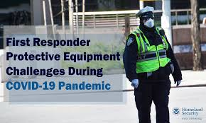
Standards and Guidelines
Standards/Guidelines offers a technical framework to enable sound decision making in the following:
trade studies
system performance
risk
cost
schedule
Assist first responders and law enforcement to answer the basic question, “What equipment will do the job?”
Improves the technology being developed.
Ensures performance requirements.
https://www.dhs.gov/science-and-technology/first-responder-protective-equipment-challenges-during-covid-19
Notes:
UNIT 2: Science and Technology in Homeland Security
LESSON 3: S&T Programs for Defense Against Catastrophic Threats
Standards and guidelines
Standards/guidelines offers a technical framework to enable sound decision making in the following: trade studies, system performance, risk, cost and schedule.
Assist first responders and law enforcement to answer the basic question, “what equipment will do the job?”
Improves the technology being developed.
Ensures performance requirements

Slide 9
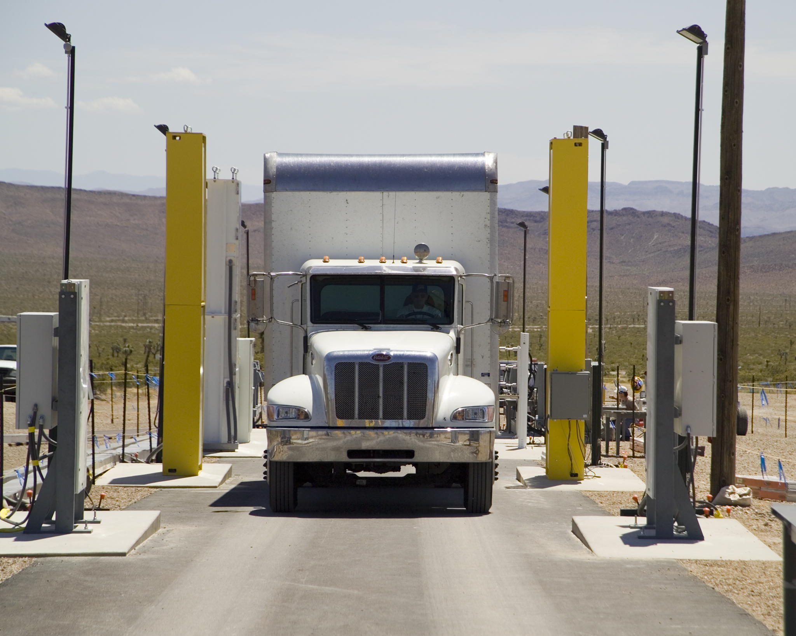
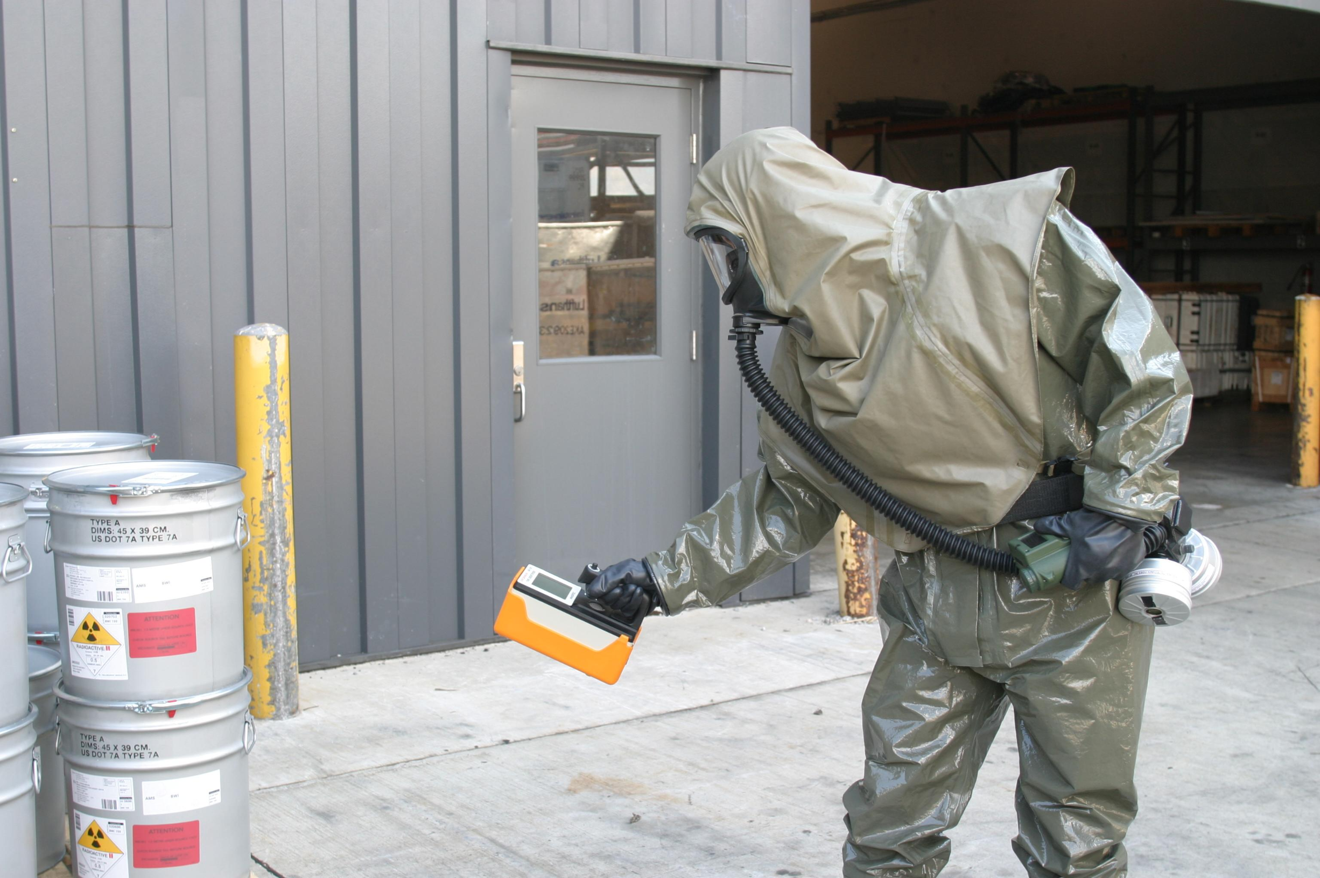
Borders Security: Nuclear and Radiological Detection
S&T invest in border security research and development of technologies to secure the borders by air, land, and port of entry.
Research and development will provide solutions to prevent illegal entry of persons, weapons (nuclear & radiological), contraband, and dangerous goods from entering the U.S.
https://www.epa.gov/radtown/radiation-and-shipping-port-security
https://fcw.com/articles/2014/10/16/covert-nuclear-detection.aspx?m=1
Notes:
UNIT 2: Science and Technology in Homeland Security
LESSON 3: S&T Programs for Defense Against Catastrophic Threats
Borders security: nuclear and radiological detection
S&T invest in border security research and development of technologies to secure the borders by air, land, and port of entry.
Research and development will provide solutions to prevent illegal entry of persons, weapons (nuclear & radiological), contraband, and dangerous goods from entering the U.S.

Slide 10
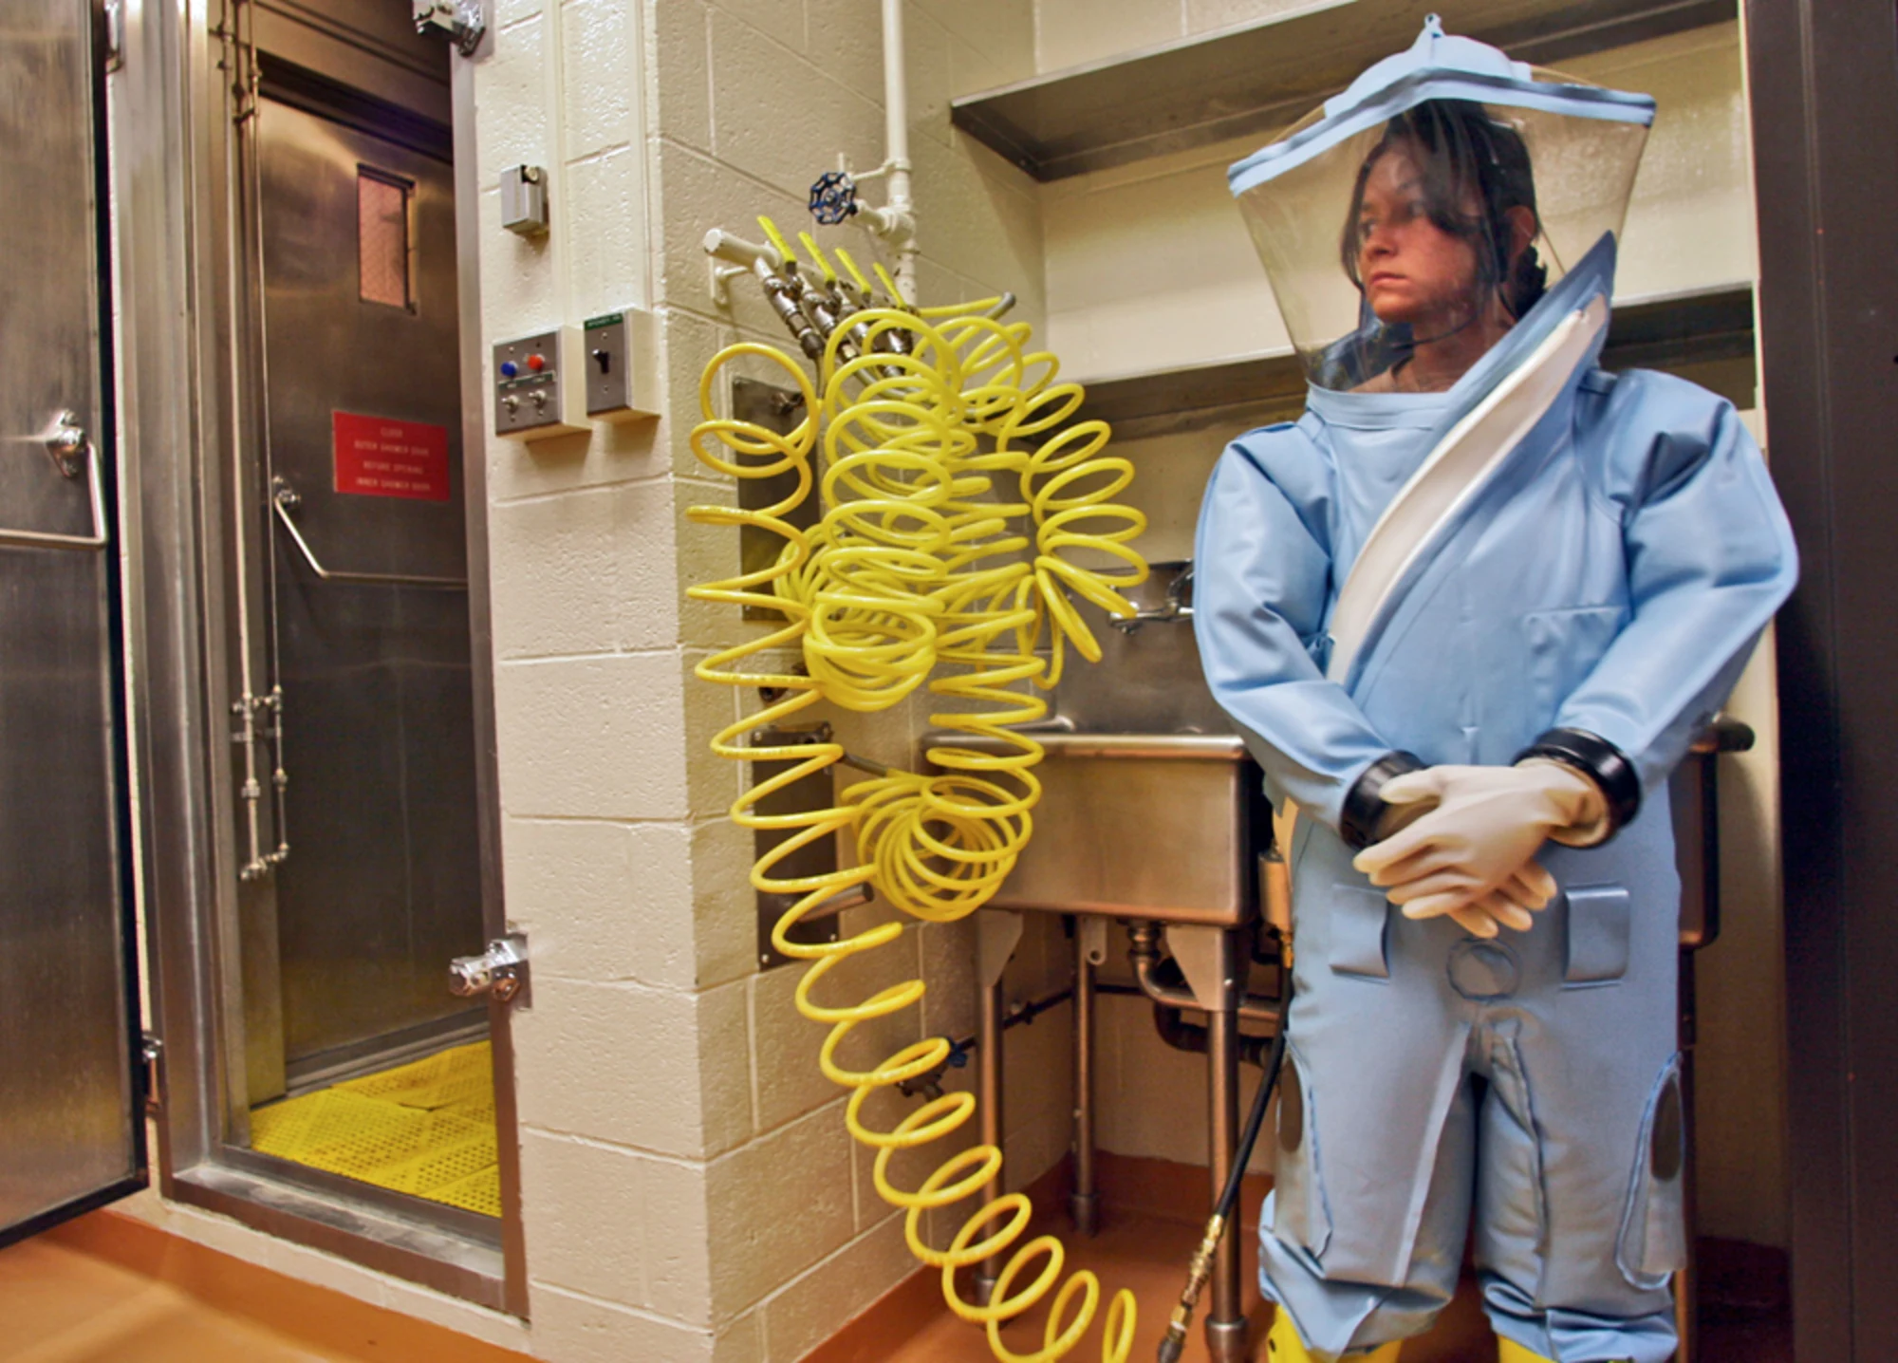
Project BioDefense
National initiative.
Supports the advancement of early detection capabilities for timelier acquisition of relevant information.
One of three initiatives from the president of the United States to improve national preparedness.
Considers public health needs.
https://www.nbcnews.com/id/wbna14083374
Notes:
UNIT 2: Science and Technology in Homeland Security
LESSON 3: S&T Programs for Defense Against Catastrophic Threats
Project BioDefense
National initiative
Supports the advancement of early detection capabilities for timelier acquisition of relevant information.
One of three initiatives from the President of the United States to improve national preparedness.
Considers public health needs.

Slide 11
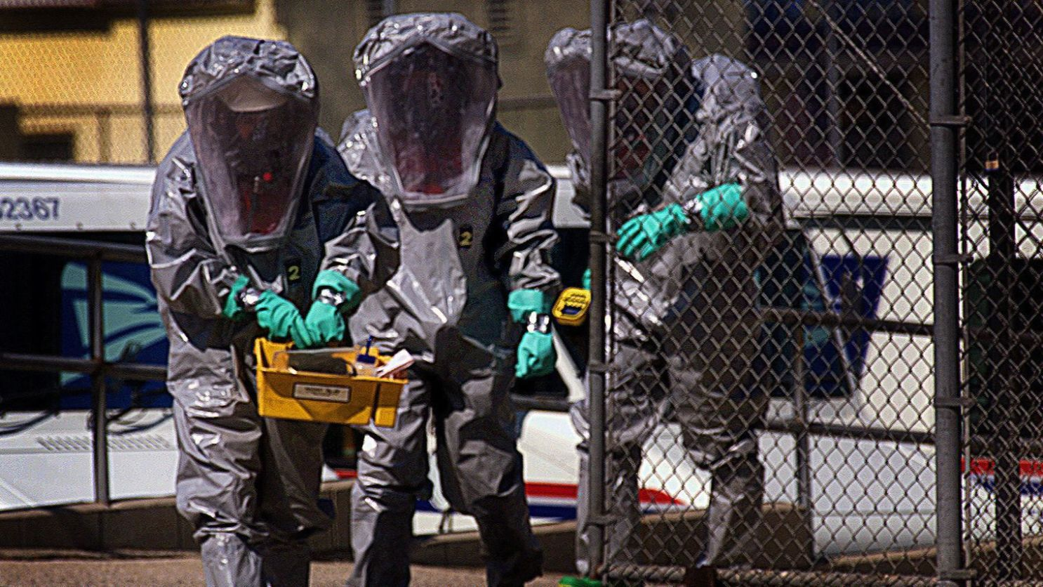
Project BioWatch
DHS program that provides air-monitoring, analysis, notification procedures, and risk assessments to 30 or more jurisdictions.
BioWatch stakeholders include public health, emergency management, law enforcement, labs, and scientific and environmental health organizations.
BioWatch continues to evolve as threats change. BioWatch will be upgraded to achieve the following: better address a wide arrange of bioterrorism threats, provide real-time data across the Homeland Security enterprise, and improve information sharing between federal, state, and local operators.
https://www.latimes.com/politics/la-na-pol-biowatch-replacement-20190215-story.html
Notes:
UNIT 2: Science and Technology in Homeland Security
LESSON 3: S&T Programs for Defense Against Catastrophic Threats
Project BioWatch
DHS program that provides air-monitoring, analysis, notification procedures, and risk assessments to 30 or more jurisdictions.
BioWatch stakeholders include public health, emergency management, law enforcement, labs, scientific and environmental health organizations.
BioWatch continues to evolve as threats change. BioWatch will be upgraded to achieve the following: better address a wide arrange of bioterrorism threats, provide real-time data across the Homeland Security enterprise, and improve information sharing between federal, state, and local operators.

Slide 12
Student Activity: Bio Program Comparisons
Prepare a report:
Explain the difference between Project BioDefense and Project BioWatch. Pay particular attention to the public health aspects.

Slide 13
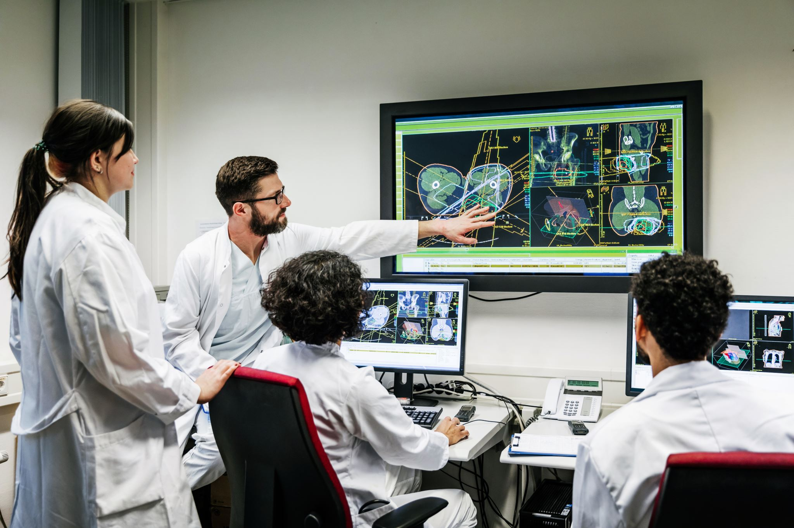
Student Activity: Bio Program Comparisons
Prepare for a discussion:
What should be the highest priority science and technology initiatives or systems in place to contribute most significantly to U.S. homeland security?

